Slide 1
EN 410 Energy Management
Gurubalan Annadurai
guru.a@iitb.ac.in

Slide 2
Recap
Basics of Combustion
3 Ts to optimize combustion
Air-Fuel ratio and Excess air
Air pollutants, types, source, heath effects and elimination techniques

Slide 3
Why steam?
Used for power generation and as process fluid
Steam – Commonly used for process heat
High heat content, easily available, cheap
High heat transfer coefficient
Low maintenance
Steam lines are light-weight
Steam flows in response to pressure drop; no need for circulating pump

Slide 4
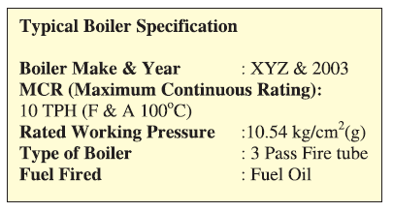
Boiler
According to Indian Boilers Act 2007
“Boilers means a pressure vessel in which stream is generated for use external to itself by application of heat which is wholly or partly under pressure when steam is shut off but does not include a pressure vessel
Capacity less than 25 liters
< 1kg/cm² design gauge pressure
Water heated below 100℃”

Slide 5
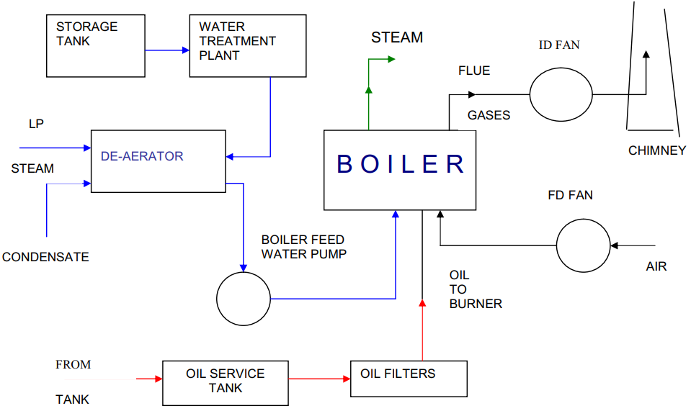
Boiler System

Slide 6
Performance Evaluation
Boiler Evaporation Ratio
Efficiency
kilogram of steam generated per kilogram of fuel consumed
Biomass fired boiler: 2 to 3
Coal fired boiler: 4 to 5.5
Oil fired boiler: 13.5 to 14.5
Gas fired boiler: 11 to 13
Useful for day to day performance comparison to get an overview of boiler efficiency
Standard for Boiler Efficiency Testing (IS 8753, ASME PTC-4-1 and BS845)
Direct Method: energy gain of the working fluid is compared with the energy content of the boiler fuel
Indirect Method: efficiency is calculated based on losses and energy input

Slide 7
Boiler Efficiency – Direct Method

Slide 8
Measurement for Direct Method
Steam flow rate and conditions (p,T)
Water inlet conditions (T,p)
Fuel flow rate and composition
Air flow rate and temperature
Blowdown should be avoided if it is intermittent blowdown boiler
Loss should be accounted if it is continues blowdown boiler
Steady operation

Slide 9
Boiler Efficiency – Direct Method
Advantages
Plant people can evaluate quickly the efficiency of boilers
Requires few parameters for computation
Needs few instruments for monitoring
Disadvantages
Does not give clues to the operator as to why efficiency of system is lower
Does not calculate various losses accountable for various efficiency levels

Slide 10
Problem 1 (Direct method)
Find out the efficiency and evaporation ration of the boiler by direct method.
Type of Boiler | Coal Fired
Quantity of steam generated | 8 TPH
Steam pressure/ tem | 10 bar/180℃
Quantity of Coal consumed | 1.8 TPH
Feed water temperature | 85 C
GCV of Coal | 13388.8 kJ/kg
Enthalpy of saturated steam | 2782.36 kJ/kg
Enthalpy of feed water | 355.64 kJ/kg

Slide 11
Indirect Method

Slide 12
Flue gas loss
The greatest fraction of the losses in a boiler is due to energy (enthalpy) of exhaust gases leaving the boiler at a temperature greater than the environment temperature.
These gases along with the energy they possess are released into the atmosphere.
Sensible energy represents the amount of energy that could be released from the exhaust gases if they were cooled to the environmental temperature.
Latent energy represents the heat released when water vapor in the exhaust is condensed at the environment temperature

Slide 13
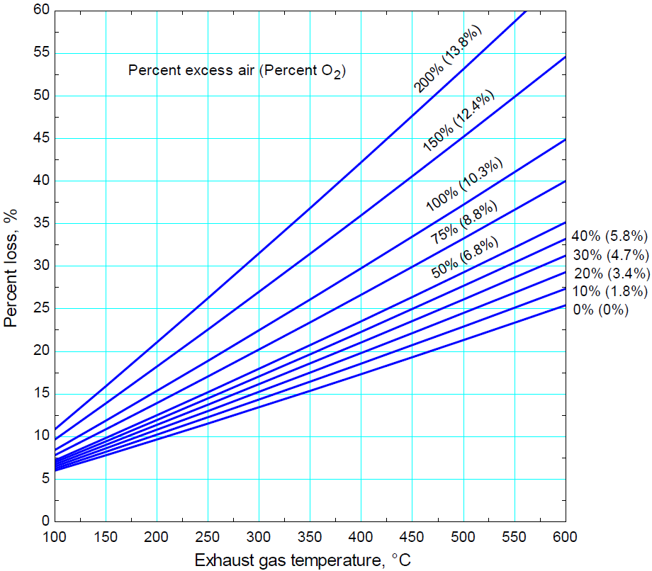
Flue gas loss
The fuel is coal with the following composition on a mass basis: 80% C, 5% H₂, 5% O₂, 2% N₂, 0.5% S, and 7.5% ash.
It has a higher heating value of 36,135 kJ/kg and a lower heating value of 34,945 kJ/kg.

Slide 14
Surface heat loss
Heat transfer losses in boilers are due to boiler surfaces having a temperature higher than the ambient.
All boilers are supposed to have adequate insulation when they are first installed but the insulation deteriorates with time and use.
Difficult to estimate
1-2% of GCV for 10 MW, 0.2-1% for 500 MW

Slide 15
Blowdown loss
Impurities in water increase during the operation of a steam boiler.
These particles also block heat transfer surfaces within the boiler.
They suspended solid particles collect in the bottom of the boiler.
These particles are removed periodically by a process called blowdown (or bottom blowdown).
The contaminated steam and condensate are removed by this blowdown process.
The blowdown process should be optimized to remove the particles effectively without bleeding off excess steam.
More than necessary blowdown causes significant fuel losses.
For example, a 5% blowdown at 3.5 bar pressure causes 1% fuel consumption whereas a 10% blowdown at 14 bar causes 3% fuel consumption.

Slide 16
Measurements for In-Direct Method

Slide 17
Precautions for Indirect Method
The efficiency test does not account for:
Standby losses: losses occur between firing intervals
Blowdown loss
Soot blower steam
Auxiliary equipment energy consumption: energy usage by auxiliary equipment burners, fans, pumps, etc.

Slide 18
Problem 2 (Indirect method) – Furnace Oil Burner
Boiler data
Fuel firing: 2650 kg/hr
Surface temperature of boiler: 80 °C
Surface area of boiler: 90 m²
Fuel analysis (in %)
Carbon: 84
Moisture:0.5
Hydrogen: 12
Nitrogen: 0.5
Sulphur:1.5
Oxygen: 1.5
GCV of Coal: 10000 kcal/kg
Flue gas analysis
V%CO₂ in flue gas: 10.8
V%O₂ in flue gas: 7.4
Flue gas temperature: 190 °C
Ambient data
Ambient temperature: 30 °C
Humidity: 0.025 kg / kg dry air
Wind velocity: 3.8 m/s

Slide 19
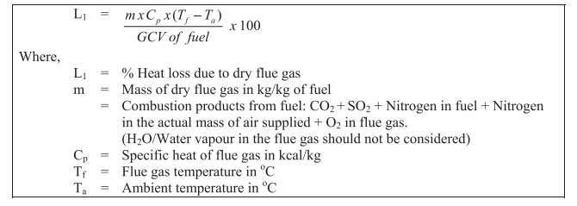
Flue Gas Heat Loss
m = Total mass of flue gas – Mass of water vapor
= Mass of air flow rate + Mass of fuel rate – (9*Hydrogen content in fuel )- Moisture content in fuel
Cp = 0.24 kcal/kg

Slide 20
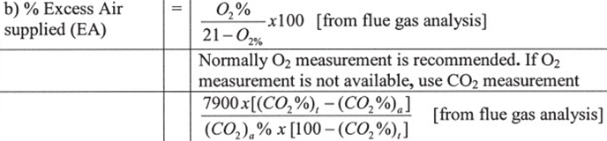
Mass flow rate of air
C + O₂ → CO₂ + 8084 kcal/kg of carbon burnt
H₂ +1/2 O₂ → H₂O + 28922 kcal/kg of H₂
S + O₂ → SO₂ + 2224 kcal/kg of S
Theoretical air
Excess air
Actual mass of supplied air

Slide 21
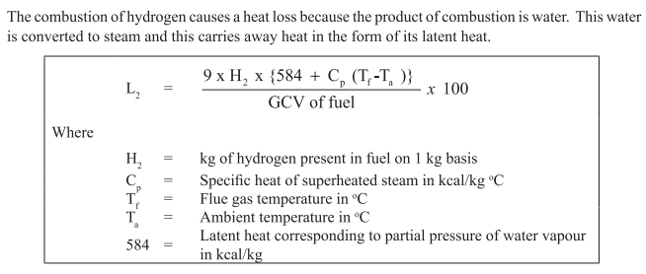
Heat Loss due to the formation of water
Cp = 0.45 kcal/kg

Slide 22
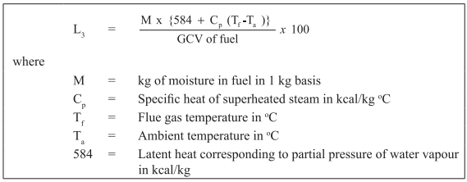
Heat Loss due to Moisture in Fuel
Cp = 0.45 kcal/kg

Slide 23
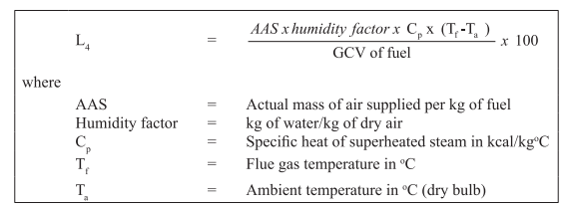
Heat Loss due to Moisture in Air
Cp = 0.45 kcal/kg

Slide 24
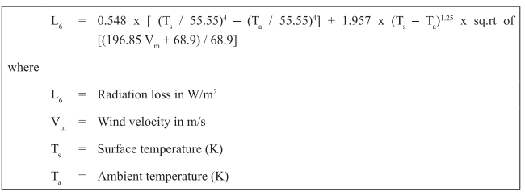
Surface heat loss
Difficult to estimate
Assumed based on type and size of boiler
Industrial fire tube boiler – 1.5 to 2.5 %
Industrial water tube boiler – 2 to 3 %
Power station boiler – 0.4 to 1%

Slide 25
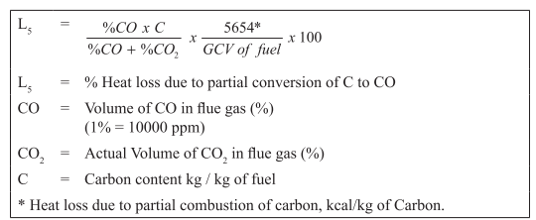
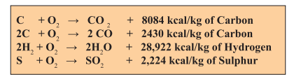
Heat Loss due to Incomplete Combustion

Slide 26
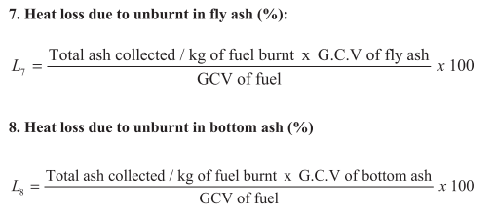
Heat Loss due to unburnt fuel

Slide 27
Boiler efficiency
Indirect efficiency = 100 – Losses

